Slide 1
High Current Pulse Generator for the Application of Transcranial Magnetic Stimulation
Advisor:
Professor Mani Mina
Clients:
Dr. Priyam Rastogi, Dr. Jayaprakash Selvaraj, Dr. Neelam Prabhu-Gaunkar, Tom Kimler
Team Members;
Curtis Richards, Yan Wang, Brian Kirkpatrick, Tania Maria Alvarado Carias, Abdul Bahashwan, Jonathan Rothfus
Notes:
Slide Presenter; Abdul

Slide 2
Sub-Teams
Power Circuit
Rectification Circuit
Microcontroller Team
Chassis Team
Notes:
Slide Presenter; Abdul

Slide 3
Functional Requirements
Peak Current 2000 Amperes Sustained for 400 Microseconds
Rise or Fall Time of 100 Microseconds
Machine Powered by a 120 V_{rms} Wall Outlet
10 Pulses a Minute
Graphical User Interface (GUI)
Machine can Accept a Wide Range of Inductive Coil Designs
Notes:
Slide Presenter; Abdul

Slide 4
Non-Functional Requirements
Multiple Rectifiers are Available for Backup in the Event of Damage
User Friendly GUI
Heavy Duty Chassis
Built in Analog Voltmeter
Less Expensive than Similar Generators on the Market
Notes:
Slide Presenter; Abdul

Slide 5
Constraints and Considerations
Managing an Achievable Scope
The Cost of an Experimental Design
Time Constraints
Component Availability
Notes:
Slide Presenter; Yan

Slide 6
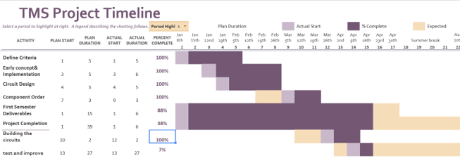
Project Milestones Spring 2018
Circuit Design
Completed Week 8
Components and Budget
Approved Week 9
Components Received
Week 11
Circuit Wiring
Completed Week 14
Operational Testing
Completed Week 15
Notes:
Slide Presenter; Yan

Slide 7
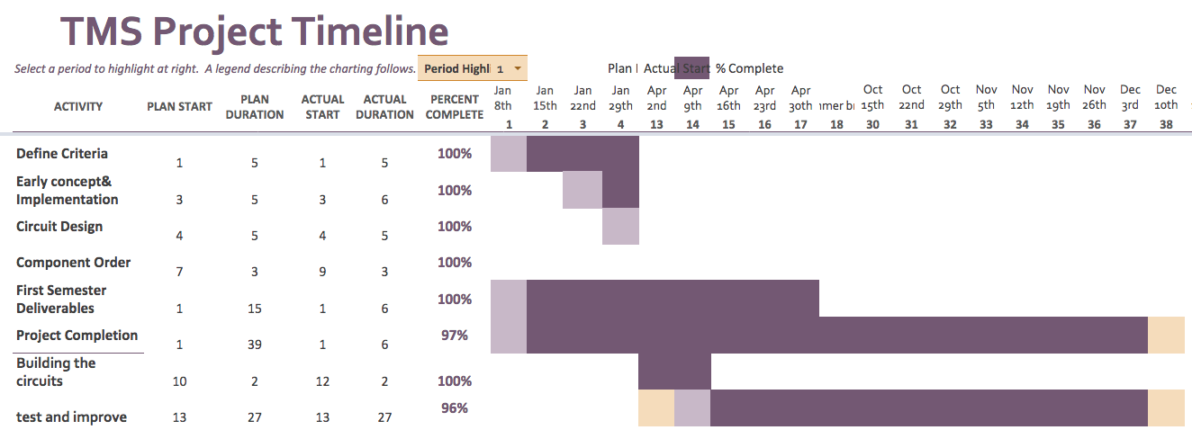
Project Milestones Fall 2018
Test and improve
Completed week 38
Additional designs
Completed week 35
Final testing
Completed week 38
Notes:
Slide Presenter; Yan
Please Update

Slide 8
Past Project Designs
Past Senior Design Teams
Lower Peak Current Goal (<1000 A)
Original Design
Unable to Source Thyristors
Notes:
Slide Presenter; Chuck

Slide 9
Block Diagram of Circuit
Wall Outlet/
Input
Rectification Circuit
Power Circuit
Output/
Coils
Micro-Controller
Notes:
Slide Presenter; Chuck

Slide 10
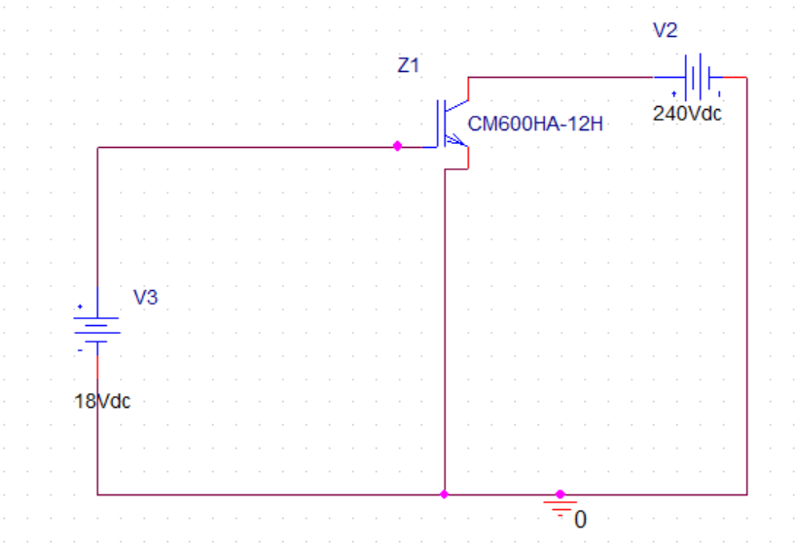
Simulation
Notes:
Slide Presenter; Chuck

Slide 11
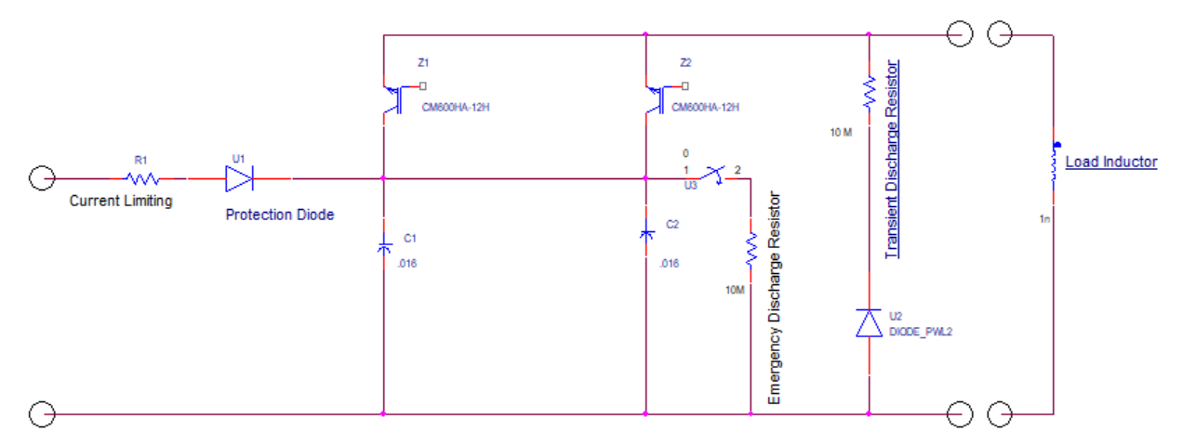
Power Circuit
Notes:
Slide Presenter; Chuck

Slide 12
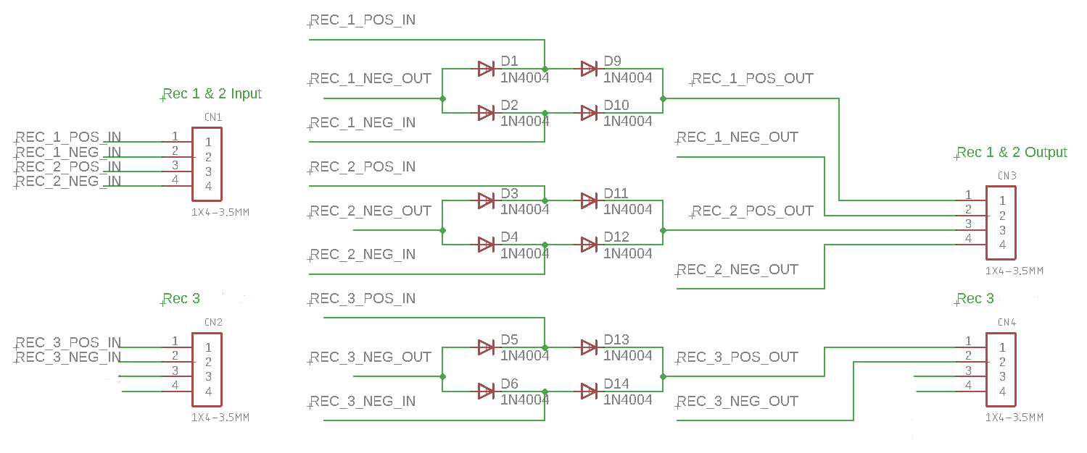
Rectification Circuit
Notes:
Slide Presenter; Chuck

Slide 13
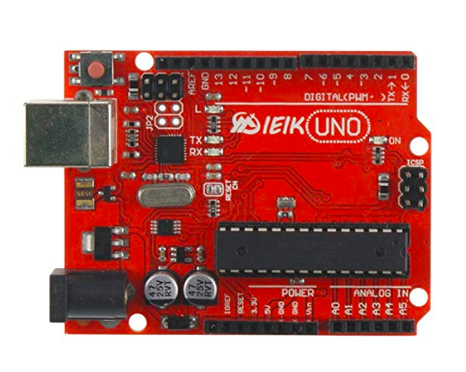
Microcontroller
A cheap, simple embedded computer
Notes:
Project needs a microcontroller
Used a clone of the popular Arduino Uno board
Available for about $15
Has enough IO pins to control fairly large project
Wrote code in Arduino web ID: conveniently backs up code in the cloud

Slide 14
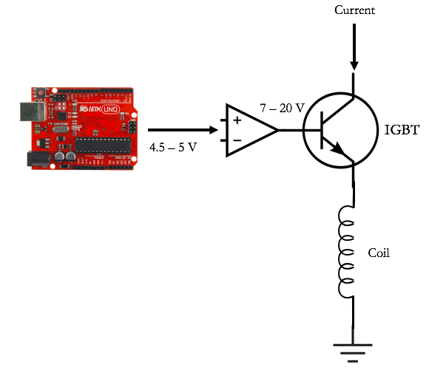
Microcontroller
Controls TMS pulses by controlling IGBT current switch
Notes:
IGBT switch is voltage controlled: MC sends a voltage pulse to IGBT to fire a pulse.

Slide 15
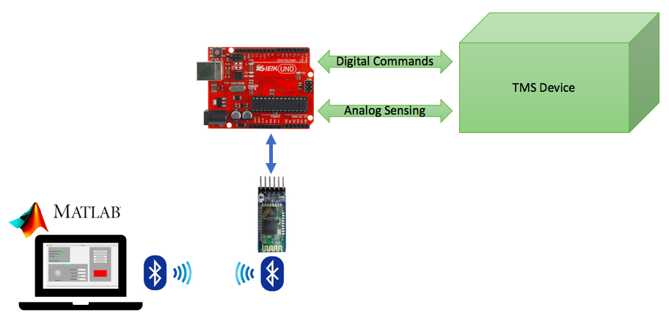
Microcontroller System Diagram
Notes:
Quickly explain high-level interaction.

Slide 16
Graphical User Interface (GUI)
Built with Matlab r2017b using the App Designer Framework
Quickly get basic GUI items in place, code behavior
Communicates with Microcontroller via Bluetooth
Wireless provides convenience and safety
Notes:
Slide Presenter: Jon
At times struggled with poor Matlab documentation
Bluetooth is a cheap solution: $10-15

Slide 17
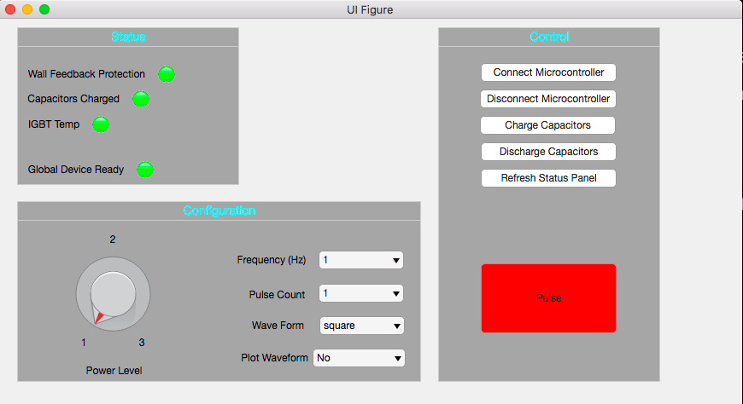
Graphical User Interface (GUI)
Notes:
Quickly touch on a couple of the GUI items.

Slide 18
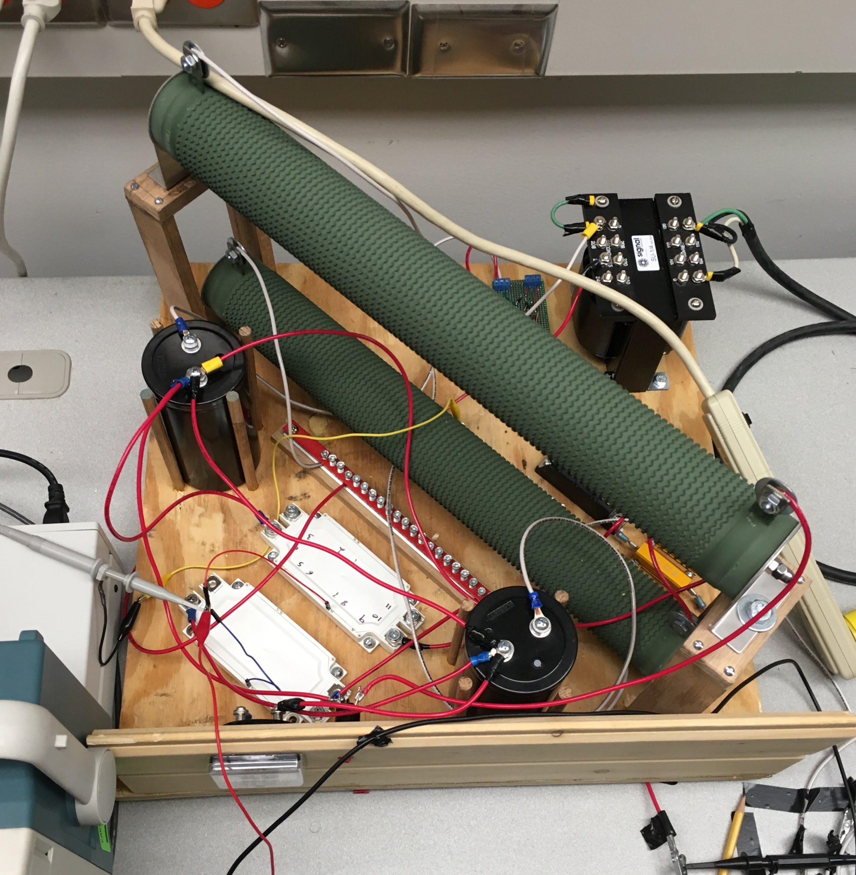
Operational Testing Overview
Testing compartmentalized
Test to Ensure Everything was Working as Designed
Monitoring outputs
Notes:
Slide Presenter; Brian
tested the small sub systemes, integrated sub systems and tested, example of us testing the magnetic field output- you can see the gauss meter in our coil.

Slide 19
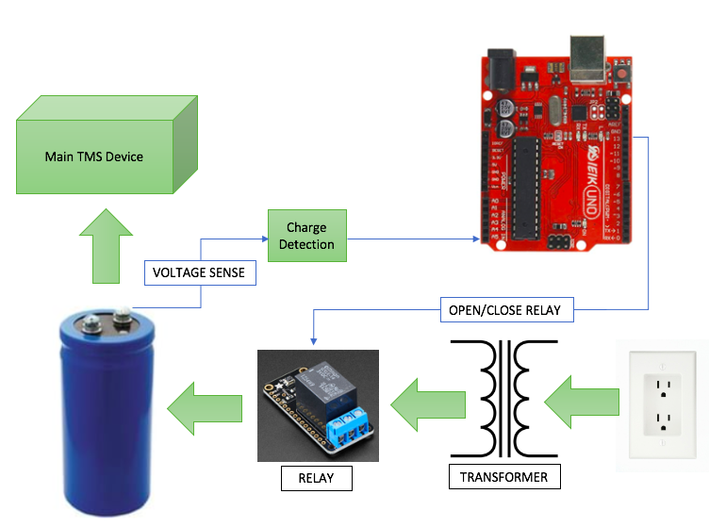
Micro-Controller Integration Testing
Notes:
Slide Presenter; Brian- The relay closes allowing the capacitor to charge, the MC monitors the V on the capacitor through the Charge detection circuit and disables the relay at a predetermined value. The capacitors are wired in parallel so this would monitor the charge simultaneously. We did bench testing on a small scale which turned an LED on and off for a visual confirmation.

Slide 20
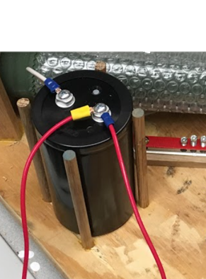
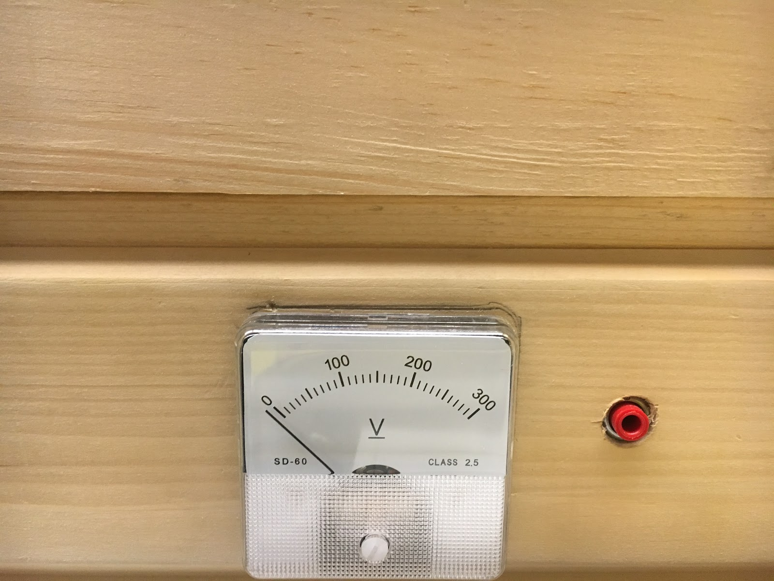
Capacitor Testing
Successfully Charged the Capacitor through the Rectification Circuit to 240 V
Accurately Measured the Voltage of the Capacitor with an Analog Voltmeter and Digital Multimeter
Charging Time is Approximately 10 seconds
Notes:
Slide Presenter; Brian

Slide 21
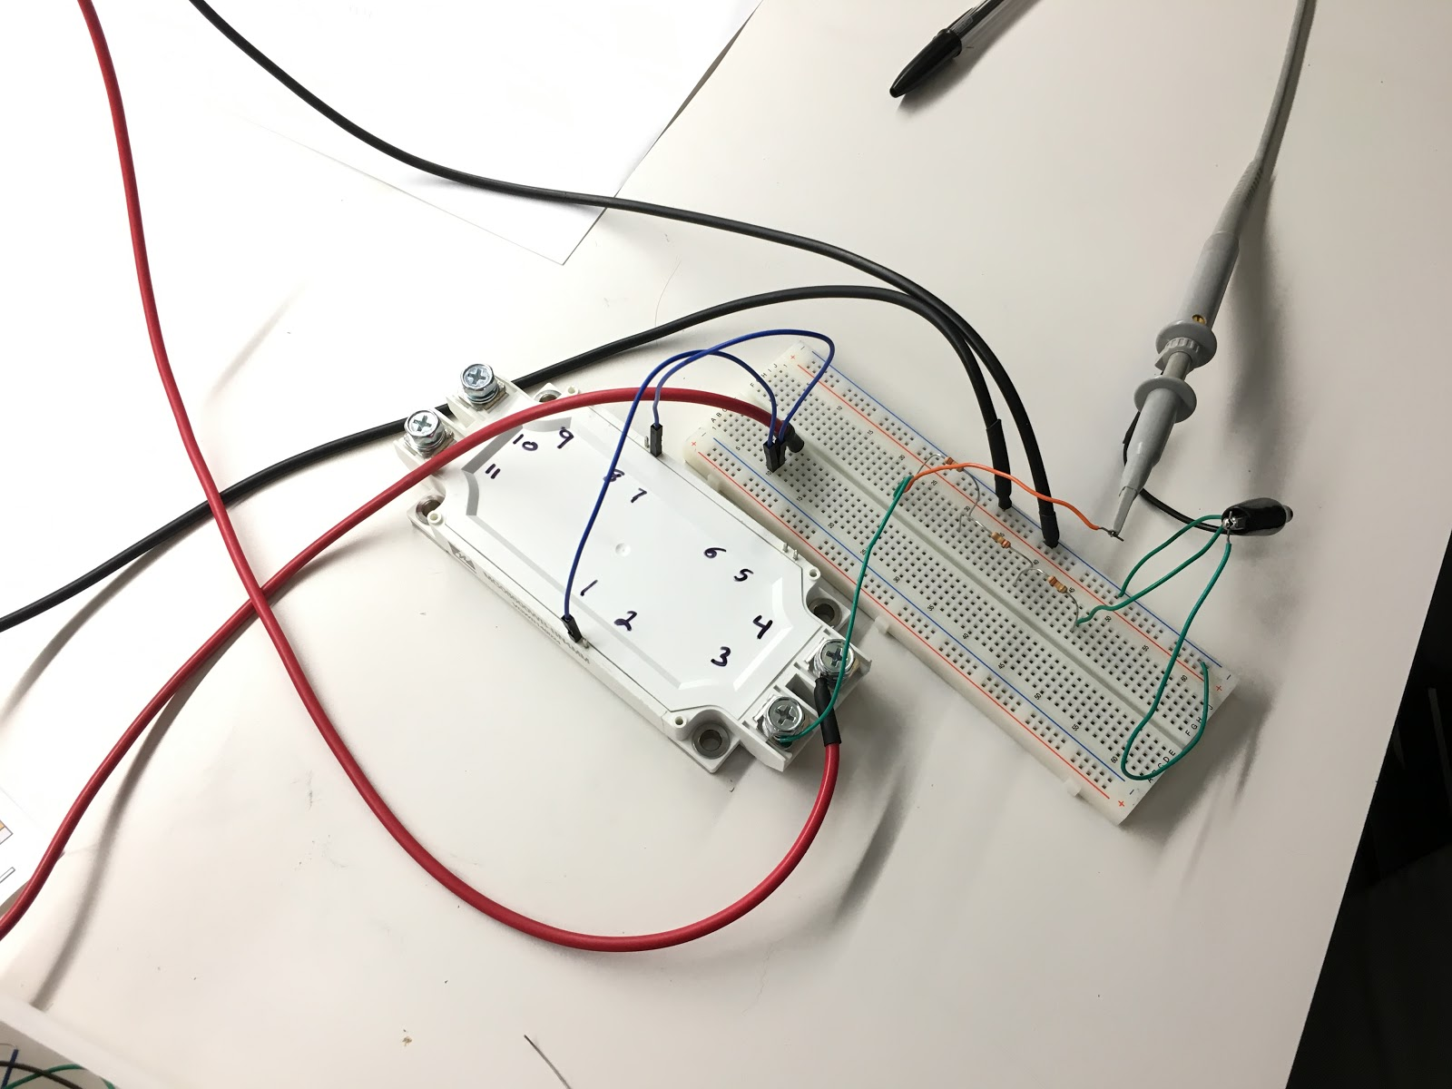
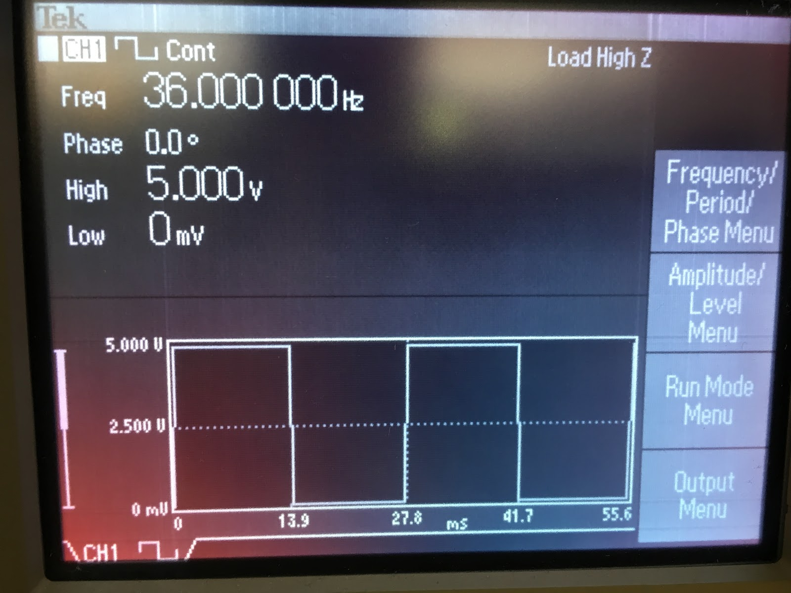
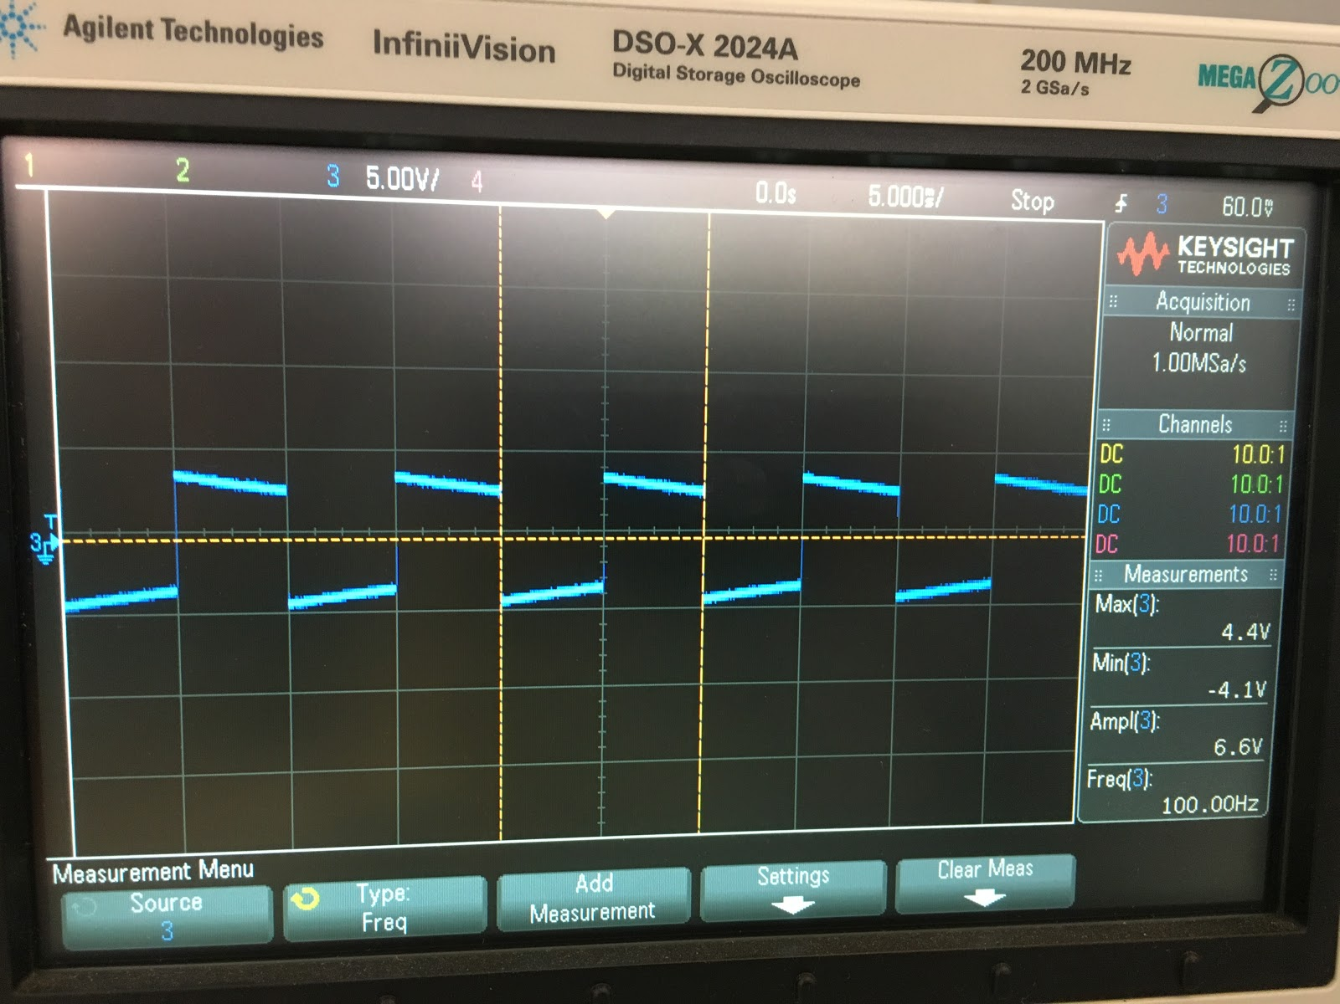
IGBT Testing
Sent a Square Wave into the Gate
with a D.C. Source as Input and
recorded the Output with the use of an Oscilloscope
Notes:
Slide Presenter; Tania
Needs formating

Slide 22
Safety
Lock Out Tag Out
IEEE Standard Test Procedures and Requirements for High-Voltage Alternating-Current Table Terminations
IEEE Standard for Digital Recorders for Measurements in High-Voltage Impulse Tests

Slide 23
Technical Challenges
The Secondary and Primary Coils of the Transformer were Electrostatically Isolated
Mounting of Capacitors
Resistor Size
MC signal boost circuit - op-amp blew up
Op-amp ground & circuit ground difference
Transistor Malfunctions
Notes:
Slide Presenter; Tania
Add our new challenges from this semester. Feel free to use an extra slide Think of things like measuring current, and alligator clips

Slide 24
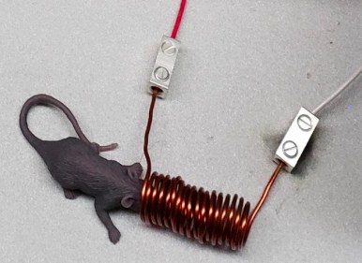
Technical Challenges
Measuring current through the coil
Small resistors
Long wire
Gauss meter
Alligator clips blowing up
Replaced alligator clips with large
terminal buses

Slide 25
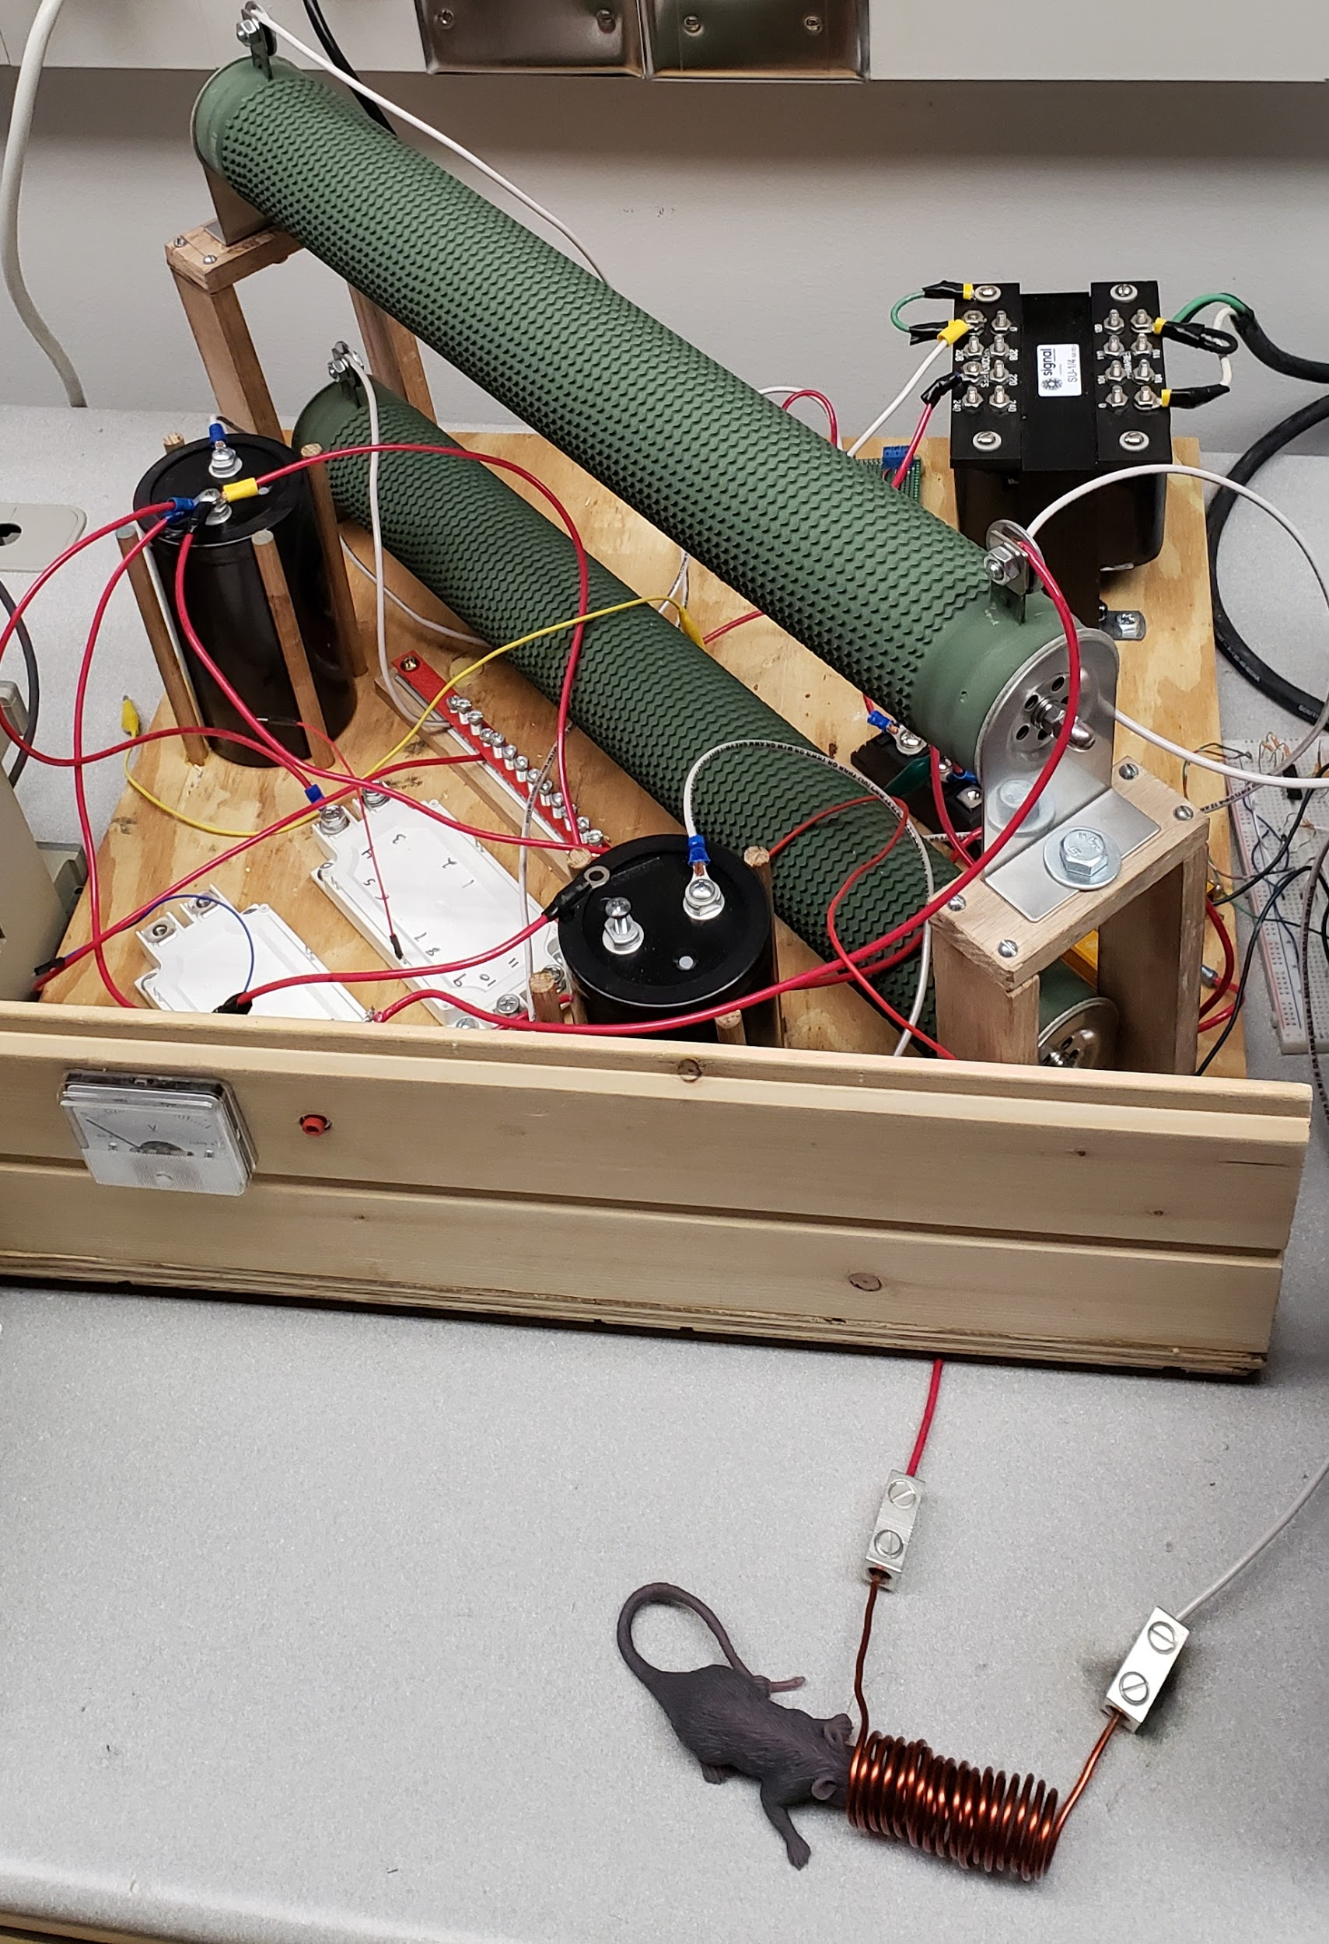
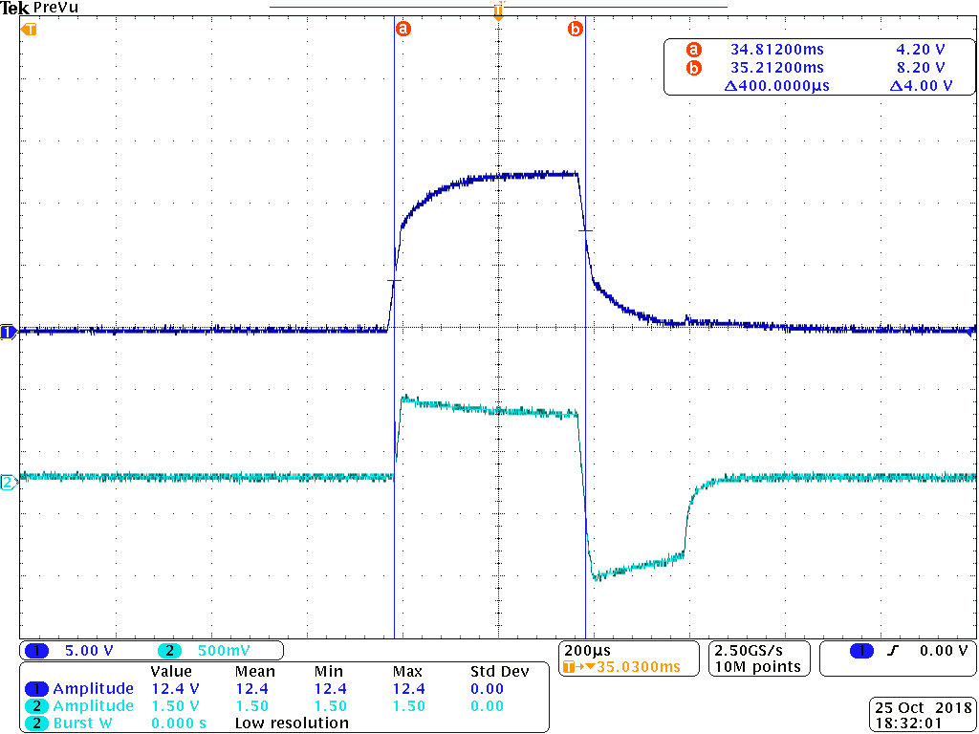
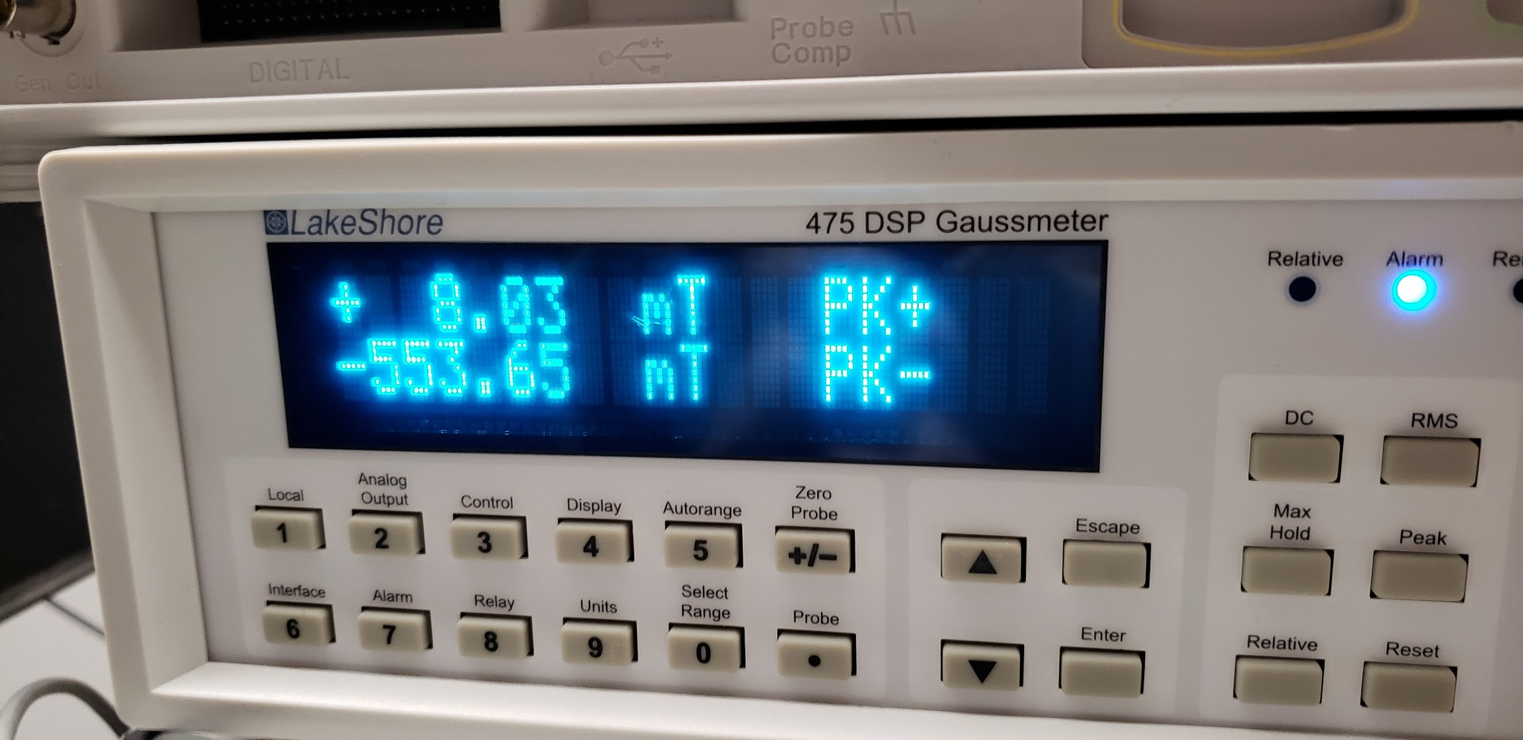
Results
Peak Magnitudes Reached
1970 A
0.56 Teslas
B=μnI
Notes:
Slide Presenter; Tania

Slide 26
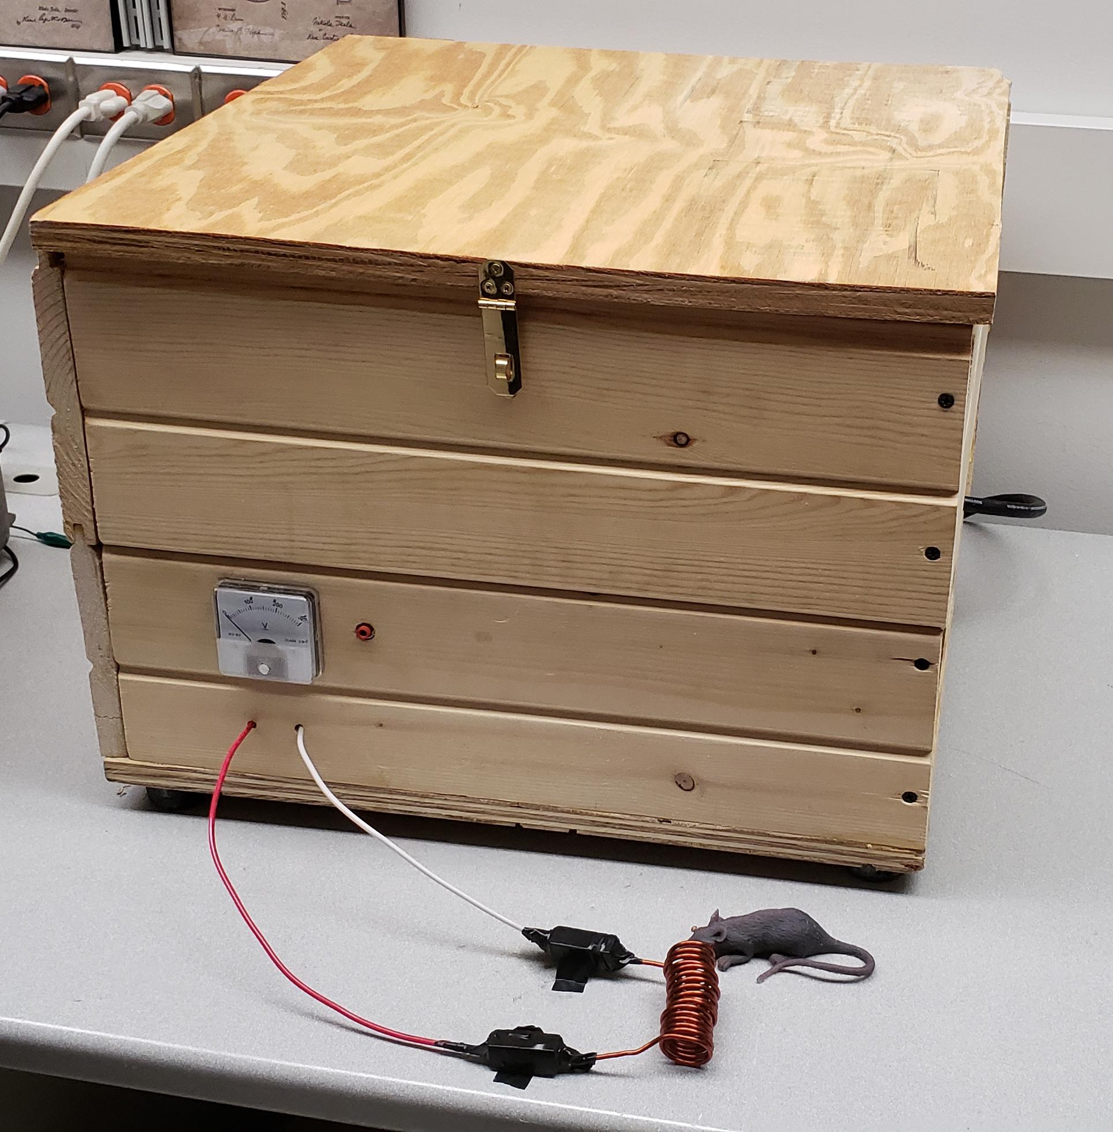
Questions?

Slide 27
Calculations
Capacitor
C = I_{peak}(Average time(t)) / △V
C = 2000A*(.0004 sec)/(240V-190V)
C = .016 F
Magnetic Field to Coil Current
B = μnI ; n = N/l = 16/7.5 cm
B = .56 Tesla
I = .56 T/(.0002848)
I = 1970 A

