Slide 1
High Current Pulse Generator for the Application of Transcranial Magnetic Stimulation
Advisor:
Professor Mani Mina
Clients:
Priyam Rastogi, Jayaprakash Selvaraj, Neelam Prabhu-Gaunkar
Team Members;
Curtis Richards, Yan Wang Brian Krkpatrick, Tania Alvarado, Abdul Bahashwan, Jonathan Rothfus
Notes:
Chuck

Slide 2
Sub-Teams
Power Circuit:
Curtis Richards, Tania Alvarado, Abdul Bahashwan
Rectification Circuit:
Yan Wang, Brian Kirkpatrick, Abdul Bahashwan
Micro-Controller Team:
Jonathon Rothfus, Brian Kirkpatrick
Chassis Team:
Tania Albarado, Yan Wang, Curtis Richards
Notes:
Chuck

Slide 3
Block Diagram of Circuit
Wall Outlet/
Input
Rectification Circuit
Power Circuit
Output/
Coils
Micro-Controller
Notes:
Brian

Slide 4
Functional Requirements
Peak Current 2000 Amperes Sustained for 400 Microseconds
Rise or Fall Time of 100 Microseconds
Machine Powered by a 120V_{rms} Wall Outlet
10 Pulses a Minute
Graphical User Interface (G.U.I)
Machine can Accept a Wide Range of Inductive Coil Designs
Notes:
Yan

Slide 5
Non-Functional Requirements
Multiple Rectifiers are Available for Backup in the Event of Damage
User Friendly G.U.I.
Heavy Duty Chassis
Built in Analog Voltmeter
Fans to Increase Circuit Cooling
Less Expensive than Similar Generators on the Market
Notes:
Abdul

Slide 6
Market Survey and Cost Analysis
Cost Calculations Include Components and Labor Overhead
Benchmarked Machine is Based off of Devices Currently used for Lab Testing
Estimated Cost Reduction of 90% per unit
Notes:
Abdul

Slide 7
Micro-Controller
Essential Functionality
Relay Control
IGBT Control
Desired Functionality
Switch Waveform Types
Switch Current Levels
Monitor IGBT Temperature
Notes:
Jon

Slide 8
Micro-Controller System Diagram
Notes:
Jon

Slide 9
G.U.I. Concept
Notes:
Jon

Slide 10
Power Circuit
Notes:
Chuck

Slide 11
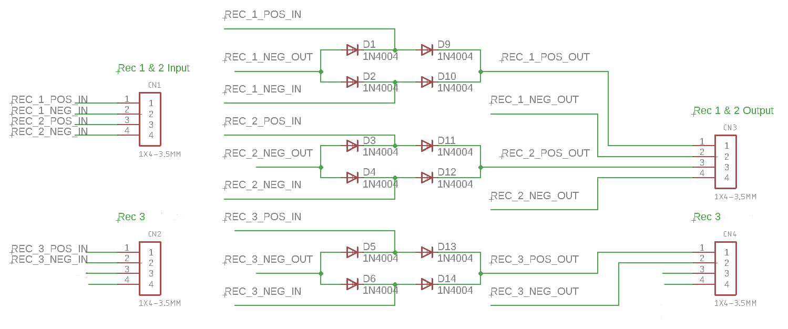
Rectification Circuit
Notes:
Brian

Slide 12
Technical Challenges
The Secondary and Primary Coils of the Transformer were Electrostatically Isolated
Mounting of Capacitors
Resistor Size
Notes:
Abdul

Slide 13
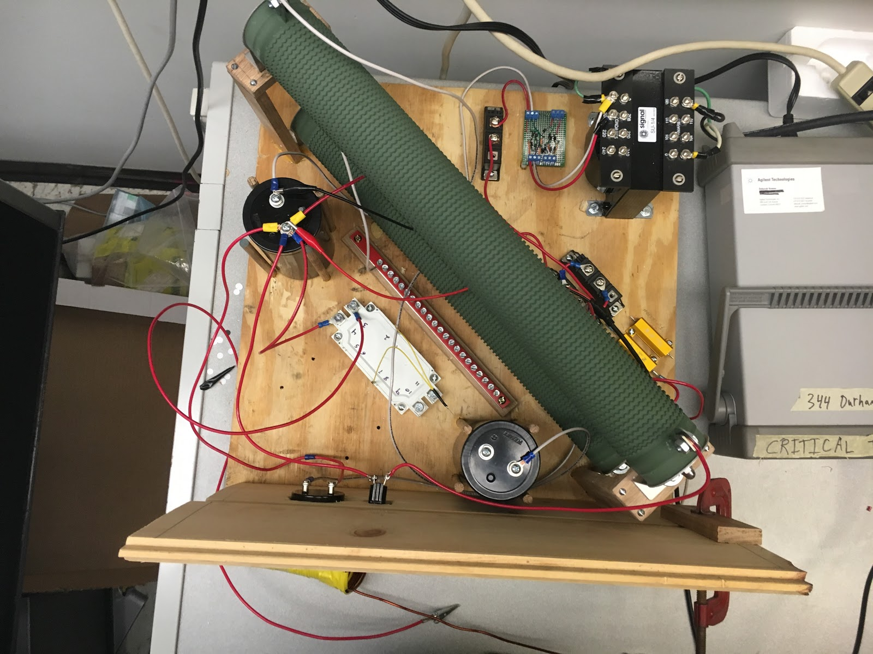
Operational Testing Overview
Test to Ensure Everything was Working as Designed
No Unforeseen Issues with Components
Notes:
Yan

Slide 14
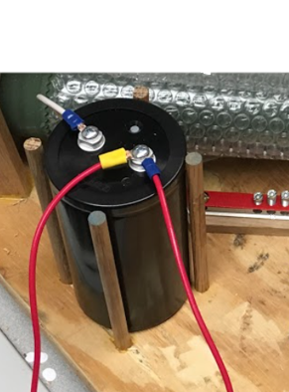
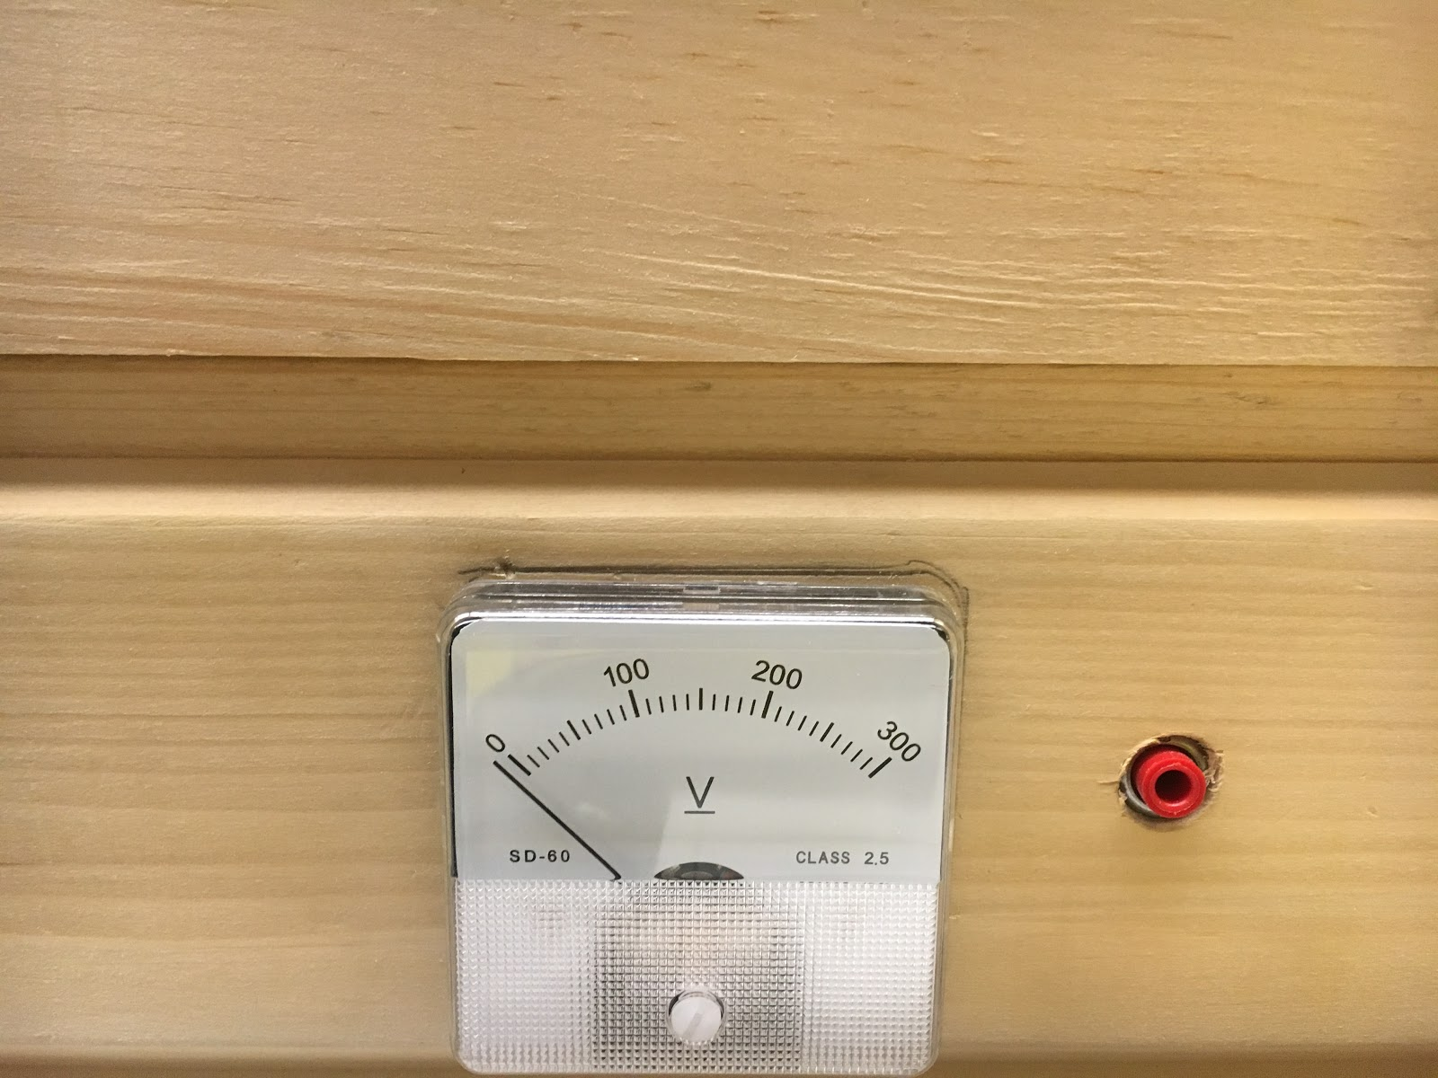
Capacitor Testing
Successfully Charged the Capacitor through the Rectification Circuit to 240 V
Accurately Measured the Voltage of the Capacitor with an Analog Voltmeter and Digital Multimeter
Charging Time is Approximately 10 seconds
Notes:
Yan

Slide 15
Rectification Testing
Each of Our Rectification Circuits have been Tested without any Faults
Tested Individually Using Function Generator, Oscilloscope, and Voltmeter
Rectifier | Capacitance | Resistance | Frequency | Amplitude (V_{rms}) | D.C. Output | Pass/Fail
1 | 1 µF | 4.5 kOhms | 60 Hz | 3 V | 5.2 V | Pass
2 | 1 µF | 4.5 kOhms | 60 Hz | 3 V | 5.2 V | Pass
3 | 1 µF | 4.5 kOhms | 60 Hz | 3 V | 5.2 V | Pass
Notes:
Yan

Slide 16
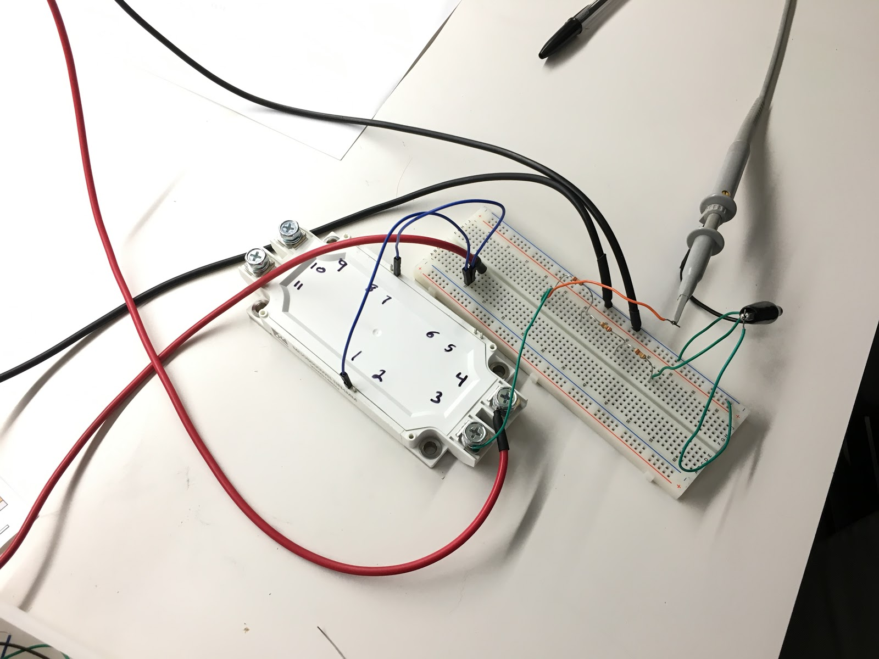
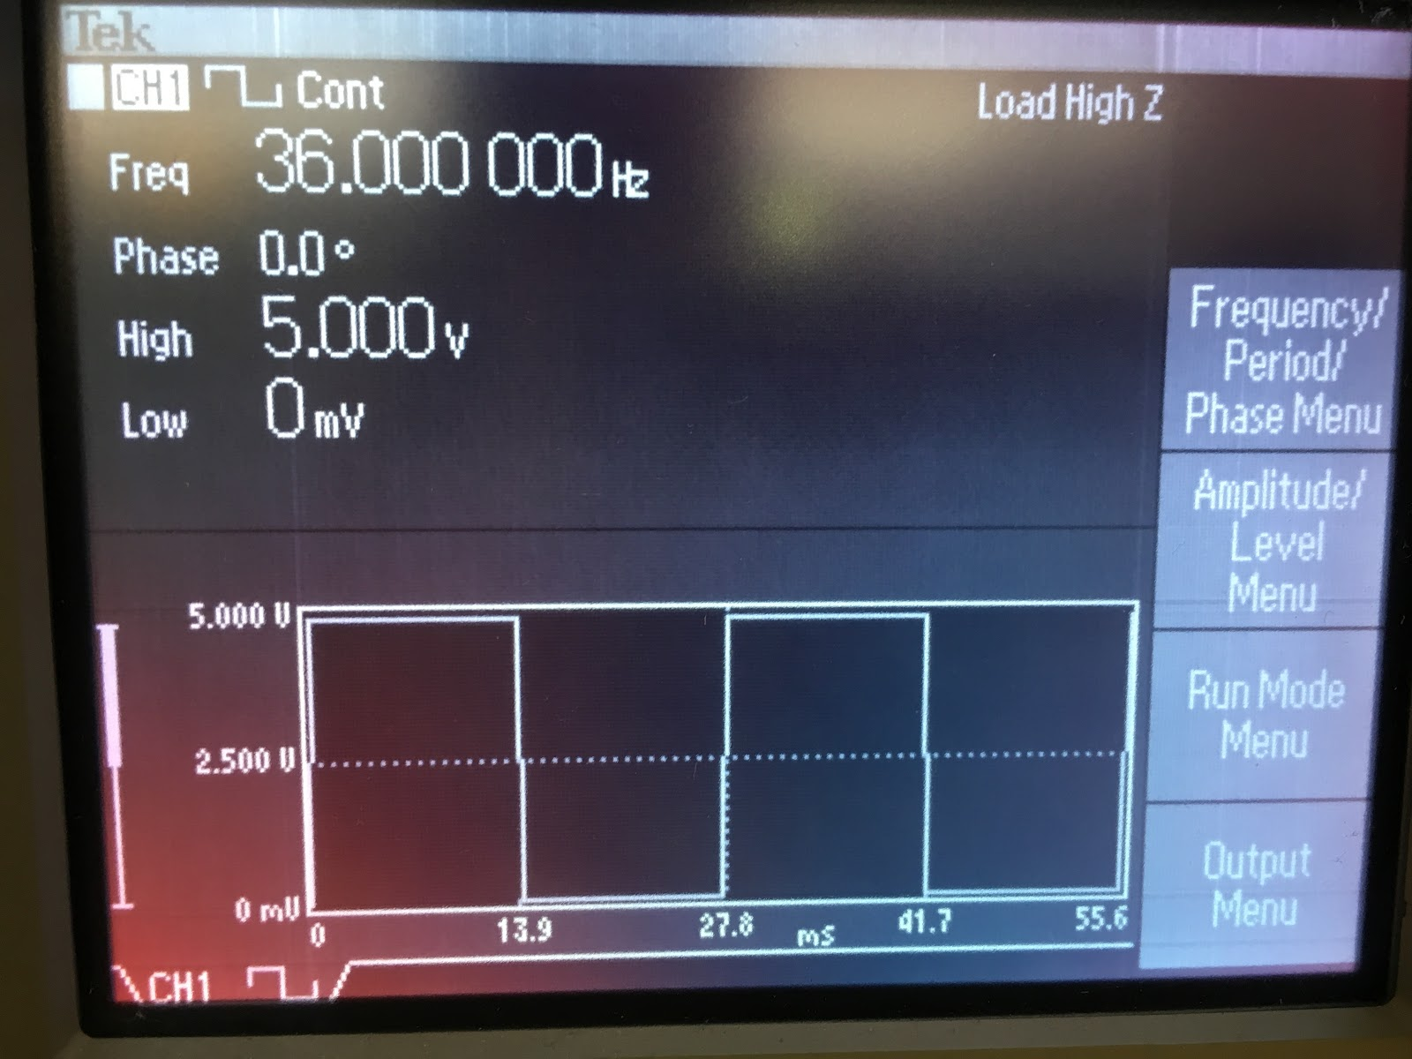
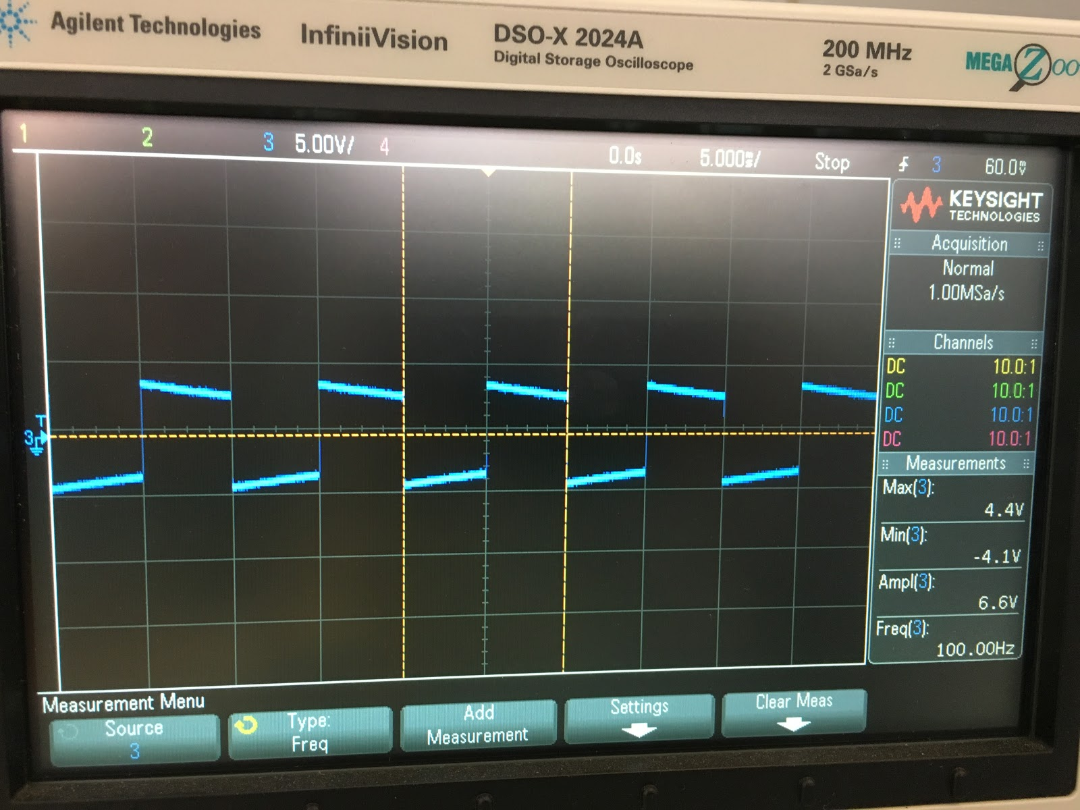
IGBT Testing
Sent a Square Wave into the Gate with a D.C. Source as Input and Recorded the Output with the use of an Oscilloscope
Notes:
Tania

Slide 17
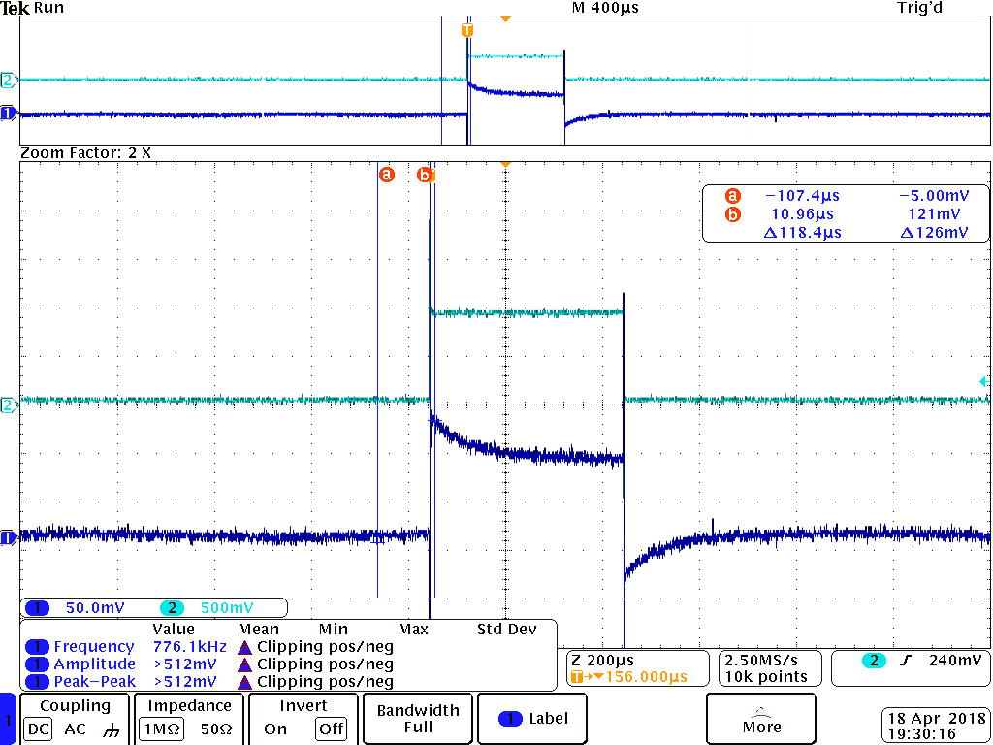
Output
Notes:
Tania & Chuck

Slide 18
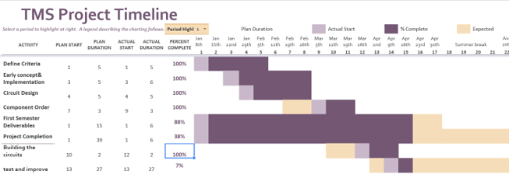
Project Milestones & Schedule
Circuit Design
Completed Week 8
Components and Budget
Approved Week 9
Components Received
Week 11
Circuit Wiring
Completed Week 14
Operational Testing
Completed Week 15
Notes:
Yan

Slide 19
Fall Schedule
Notes:
Brian

Slide 20
Questions

Slide 21
Executive Summary
Project Name: High Current Pulse Generator for the use of Transcranial Magnetic Stimulation.
Start Date: January, 14 2018 End Date: Dec 12, 2018 24, 2017
Functional Requirements:
Peak Current 2000 Amperes Sustained for 400 Microseconds
Rise or Fall Time of 100 Microseconds
Machine Powered by a 120V_{rms} Wall Outlet
10 Pulses a Minute
Graphical User Interface (G.U.I)
Machine can Accept a Wide Range of Inductive Coil Design
Block Diagram:
Define:
Wall Outlet
Rectification Circuit
Power Circuit
Output/
Coils
Micro-Controller
Non-Functional Requirements:
Multiple Rectifiers are Available for Backup in the Event of Damage
User Friendly G.U.I.
Heavy Duty Chassis
Built in Analog Voltmeter
Fans to Increase Circuit Cooling
Less Expensive than Similar Generators on the Market
Output:
Team Members: Advisor: Professor Mani Mina
Clients: Priyam Rastogi, Jayaprakash Selvaraj, Neelam Prabhu-Gaunkar
Team: Curtis Richards, Yan Wang, Brian Kirkpatrick, Tania Alvarado, Abdul Bahashwan, Jonathan Rothfus
Next Semester;
Integrate Controlling Circuit
Build and Test Biphasic Machine
SDDEC04

